Slide 1

install and set up Jenkins on an AWS EC2 instance

Slide 2
What is jenkins:
jenkins is a java-based open source automation platform .
It Was Developed by “ Sun Microsystem”.
Jenkins Run on the “ Port 8080”
it is used to non-stop process of create and test
without operation and & development there is no jenkins tool
with jenkins tools the devops tool is generate

Slide 3
Why use Jenkins:
Jenkins facilitates the automation of several stages of the software development lifecycle, including application development, testing, and deployment.
Operating within servlet containers like Apache Tomcat, the technology is server-based.Continuous delivery (CD) and integration (CI) pipelines can be created and managed with Jenkins.

Slide 4
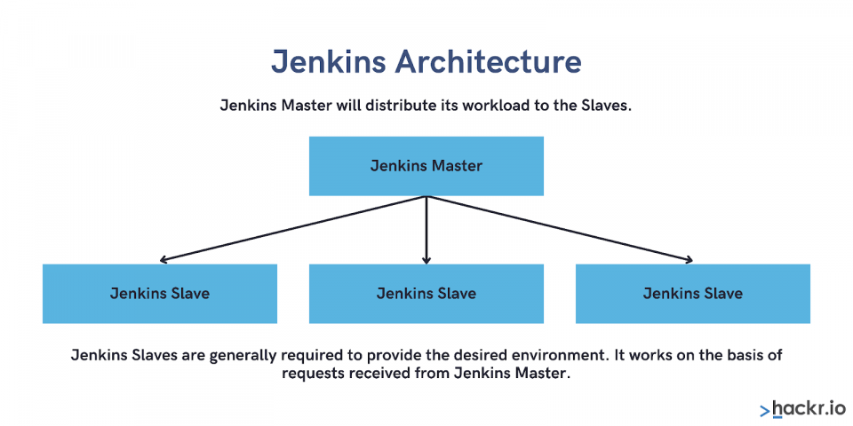
Jenkins Architecture:

Slide 5
Jenkins master will distributed its workload to the slave.
Jenkins slave will do the work provided by jenkins master.
If slave is not avaliable , then master. will change as slave and will do slave work.
for the communication between master and slave we have to install key.
the work allocation will be done by lable i.e we call keys L1 , L2 , L3 And Slave 1, Slave 2, Slave 3.

Slide 6
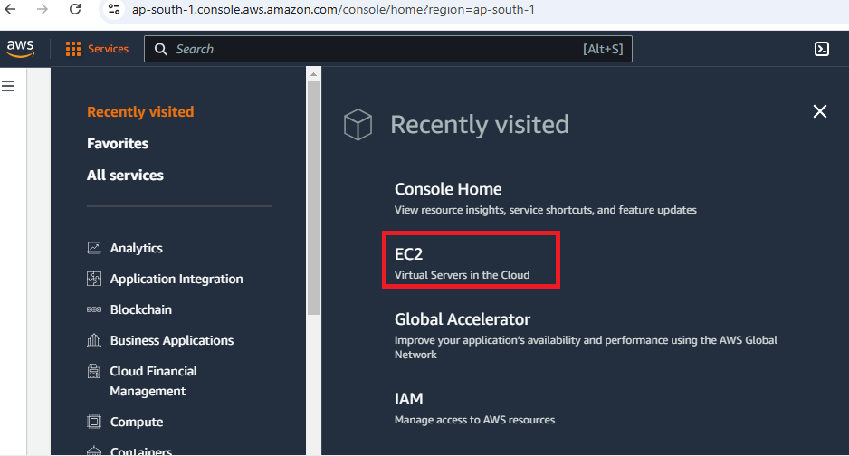
installing and setting up Jenkins on AWS EC2:-
1. AWS Account:
Sign up for an AWS account: If you don’t already have one, create an AWS account at aws.amazon.com.
2. AWS EC2 Instance:
Launch an EC2 instance:
1.Go to the AWS console and navigate to the EC2 service.

Slide 7
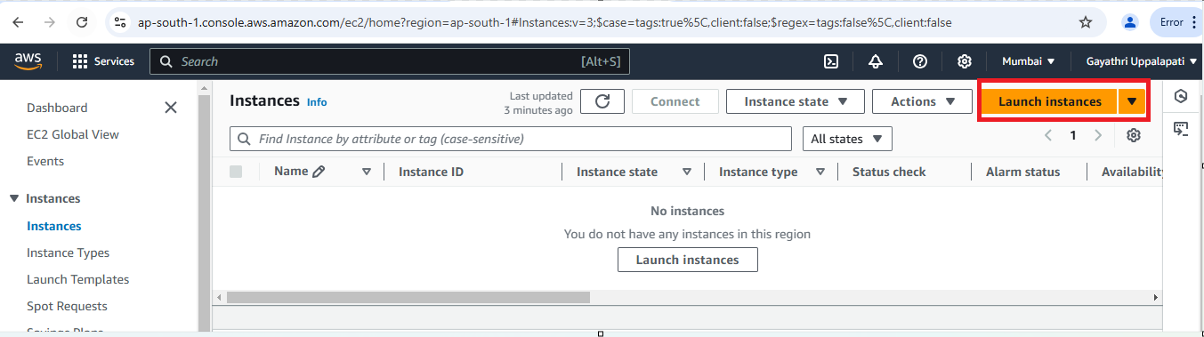
Next Click on Launch Instance button.

Slide 8
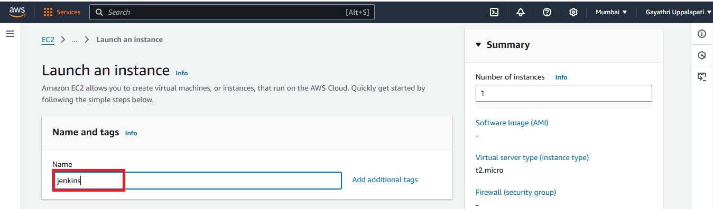
Go to the names and tags and give the Name as Jenkins (Any Name).

Slide 9
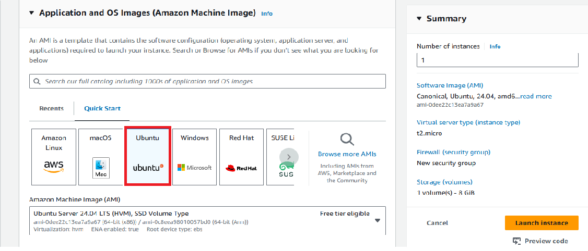
Operating System: Ubuntu Server 20.04 or 22.04 LTS.

Slide 10
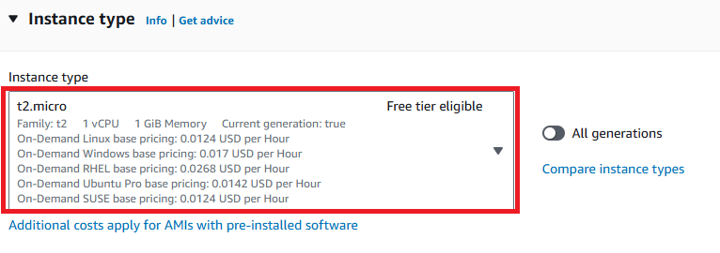
Instance type: For this an t2.micro instance (free tier eligible) will suffice.

Slide 11
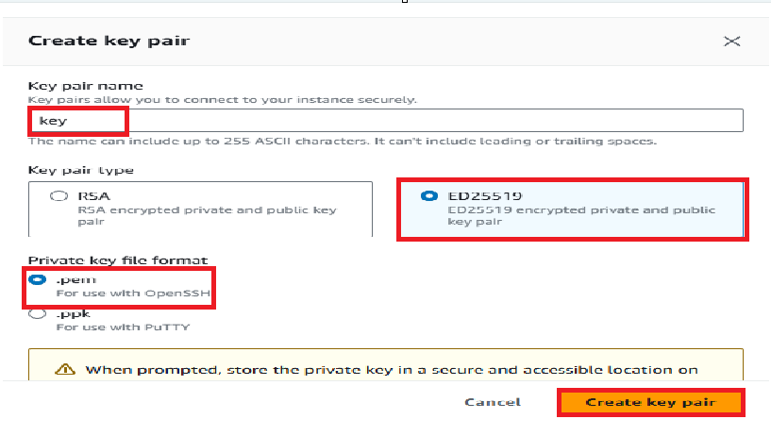
Key Pair :Choose an existing key pair or create a new key pair

Slide 12
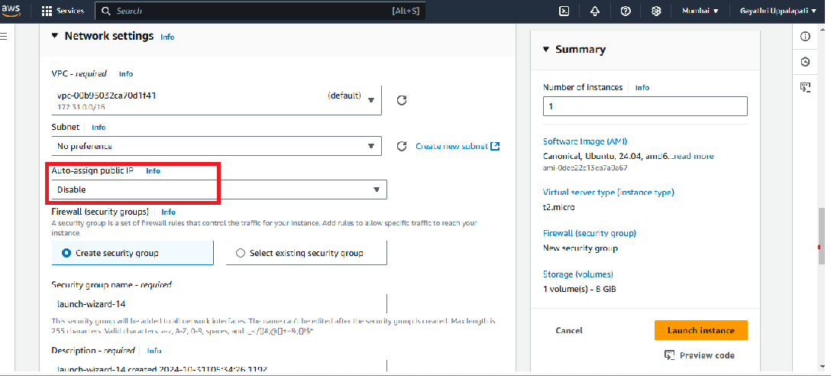
Security Group: network settings edit the auto-assign public IP as disable. and then Allow the HTTP & HTTPS then click on Edit then add security group with All TCP then All traffic click on Launch Instance.

Slide 13
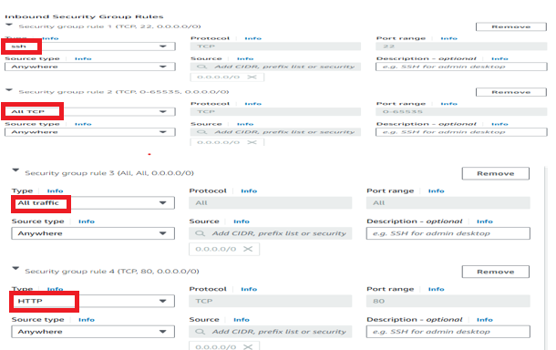

Slide 14
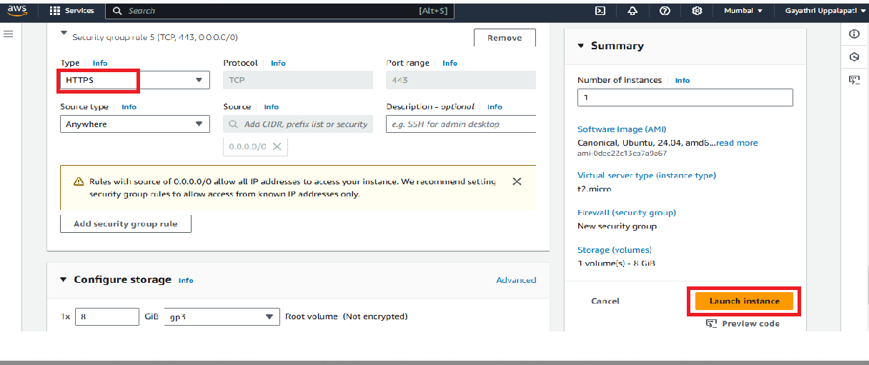

Slide 15
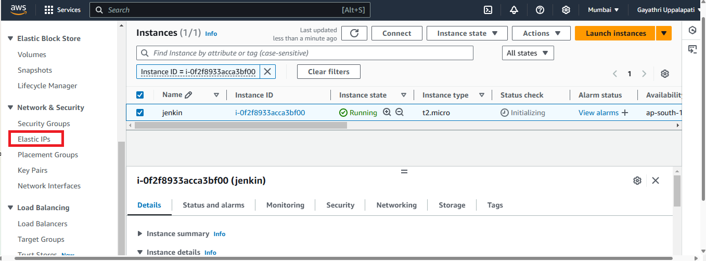
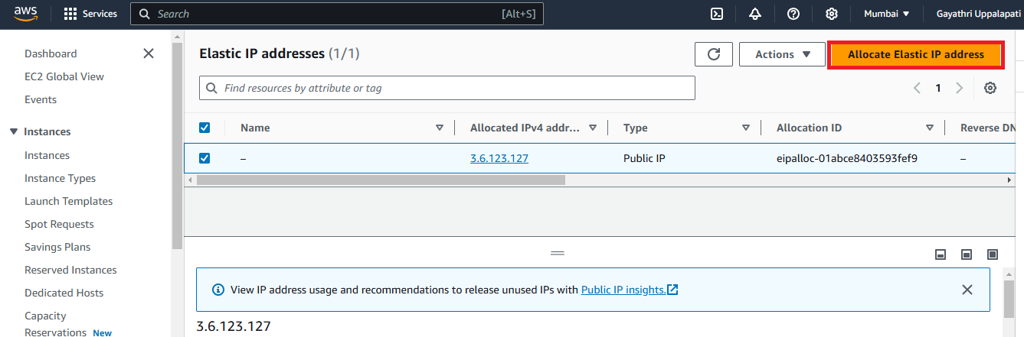
Click on the left side Elastic ips
next click on the elastic ip address and go for the allocate elastic ip address

Slide 16
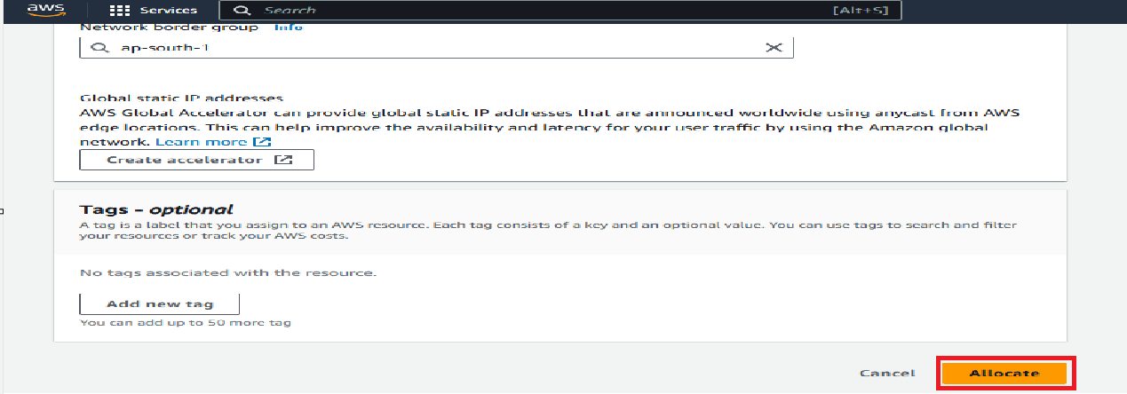
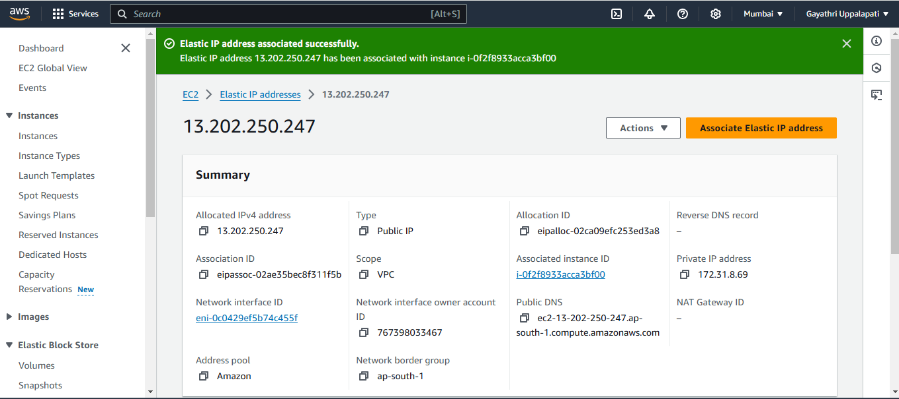
then click on the allocate
after allocate is successfully created then go for the associate elastic ip address

Slide 17
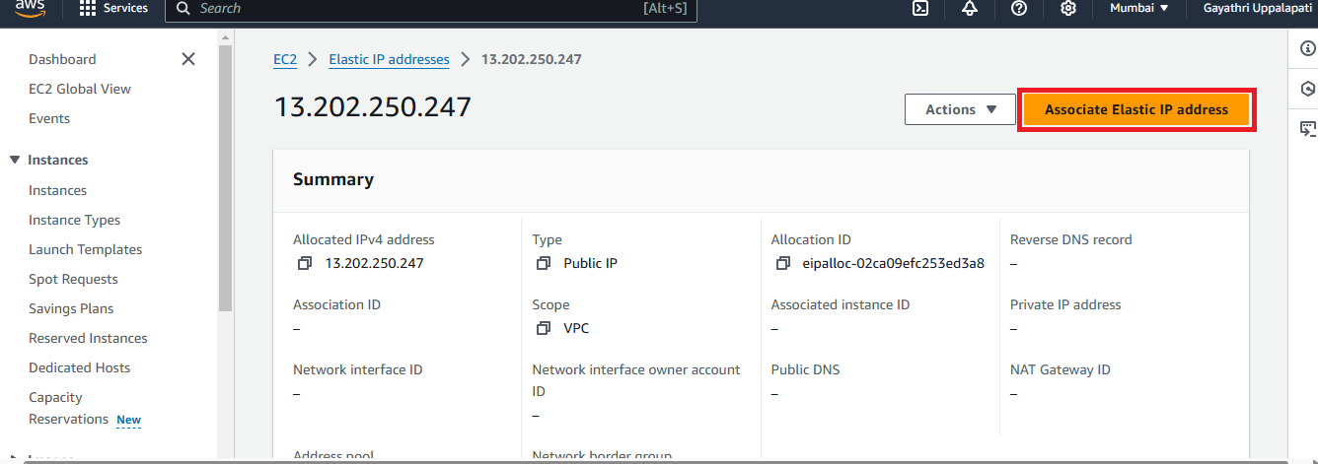
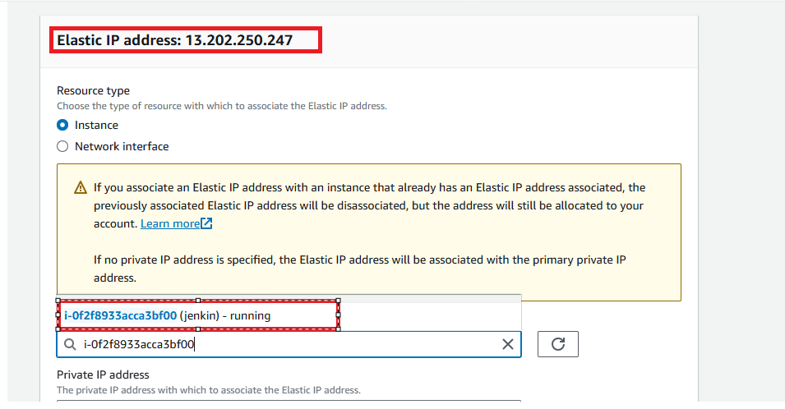
click on the resource type as instance and select the running instance and select the private ip address then click on the associate

Slide 18
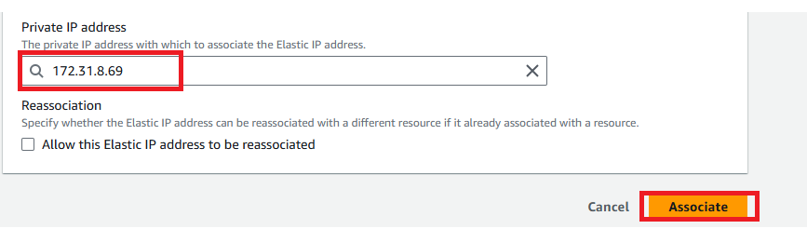
here elastic ip address is associated successfully

Slide 19
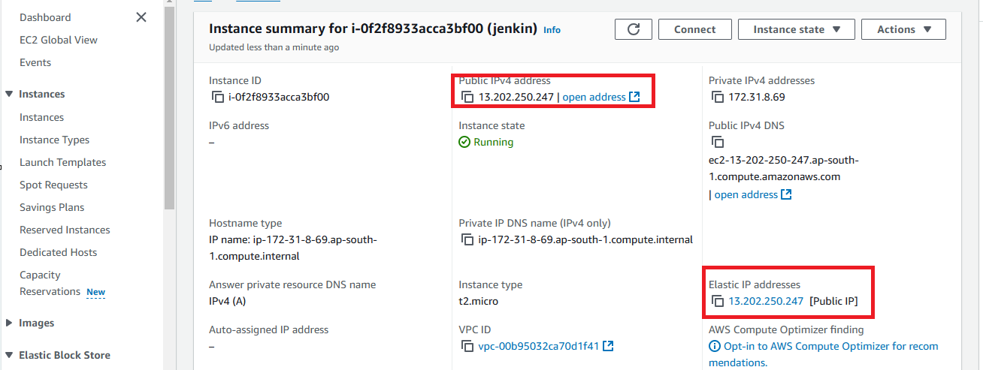
here we can see the elastic ip addresses

Slide 20
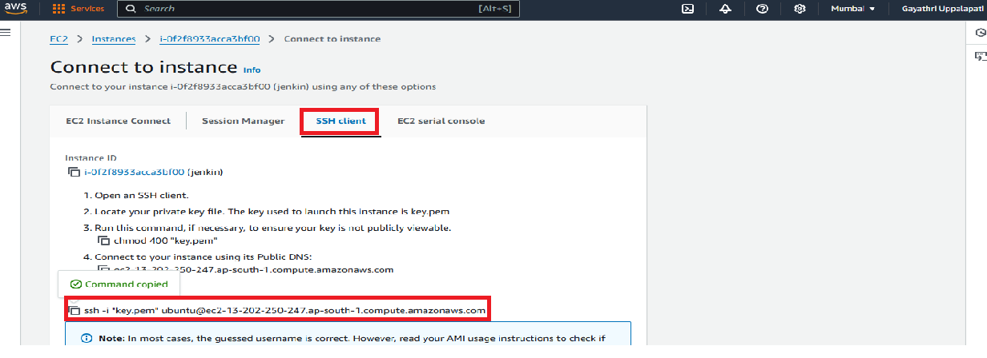
After the Instance Created then Connect the instance with any tool(GIT,Mobaxterm etc..,) with SSH Key.

Slide 21
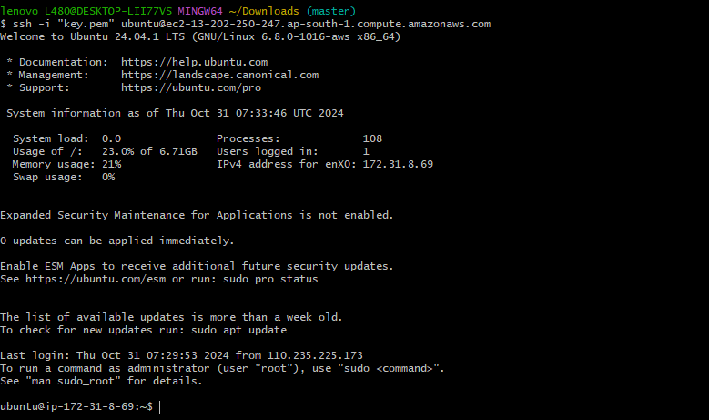
After Copy the SSH link paste that in any tool (GIT,Mobaxterm etc..,) to connect with AWS.

Slide 22

Installing and setting up Jenkins
1. Install Java
Jenkins requires Java to run. So we have to install Java before
Jenkins but firstly update the system with the following command
sudo apt update
sudo apt upgrade -y
Then Install the latest OpenJDK with this command:
sudo apt-get install fontconfig openjdk-17-jre
2. Validate a Java Installation:
We can use the following command to check the installed Java version:
java --version

Slide 23
2.Install Jenkins
1.Add the Jenkins repository and key:
sudo wget -O /usr/share/keyrings/jenkins-keyring.asc \
https://pkg.jenkins.io/debian-stable/jenkins.io-2023.key
echo "deb [signed-by=/usr/share/keyrings/jenkins-keyring.asc]" \
https://pkg.jenkins.io/debian-stable binary/ | sudo tee \
/etc/apt/sources.list.d/jenkins.list > /dev/null
2. Update your package manager and install Jenkins:
sudo apt-get update
sudo apt-get install jenkins

Slide 24
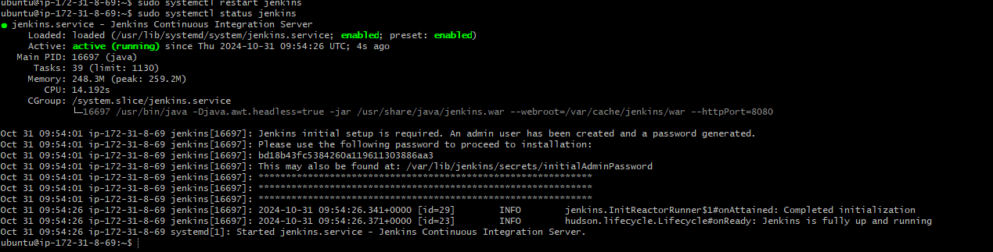
3.Start Jenkins:
Start the Jenkins service:
sudo systemctl start jenkins
Enable Jenkins to start at boot:
sudo systemctl enable jenkins
Check the Jenkins service status:
sudo systemctl status jenkins

Slide 25
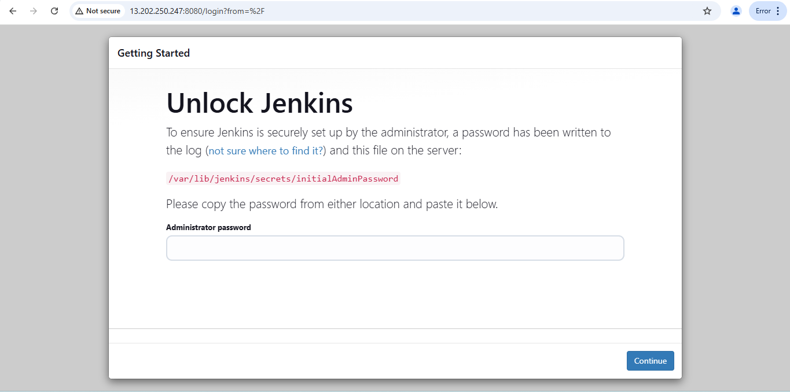
To verify the installation of Jenkins we can take the public IP of our EC2 Instance and paste it into our browser with default port of Jenkins 8080. The Jenkins page would be appear below.

Slide 26
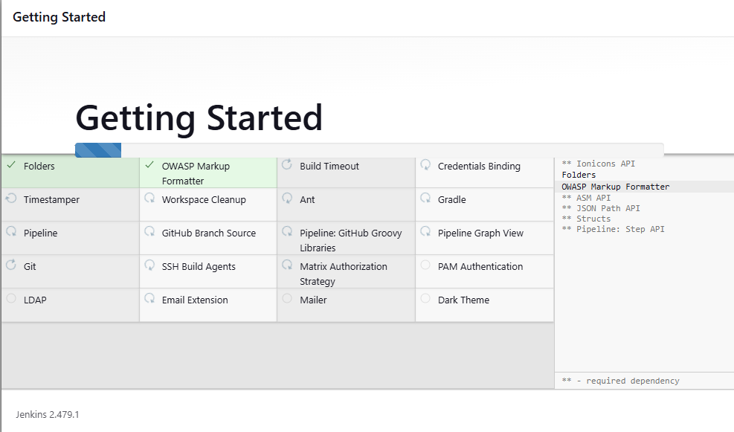
Now to unlock Jenkins we need to go to this path /var/lib/jenkins/secrets/initialAdminPassword and copy the administrative password and paste it into the above screenshot.
After pasting the password the below page will appear. Click on Install suggested plugins.
After the plugins are installed, you need to create the first Admin User. Fill in all the information and click on Save and Continue.

Slide 27
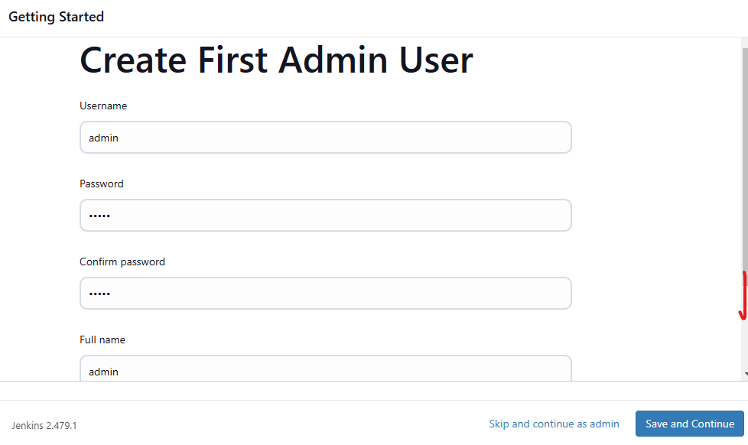
After successfully installation suggested we will get login page in that need to the enter below details.
Click on save and continue

Slide 28
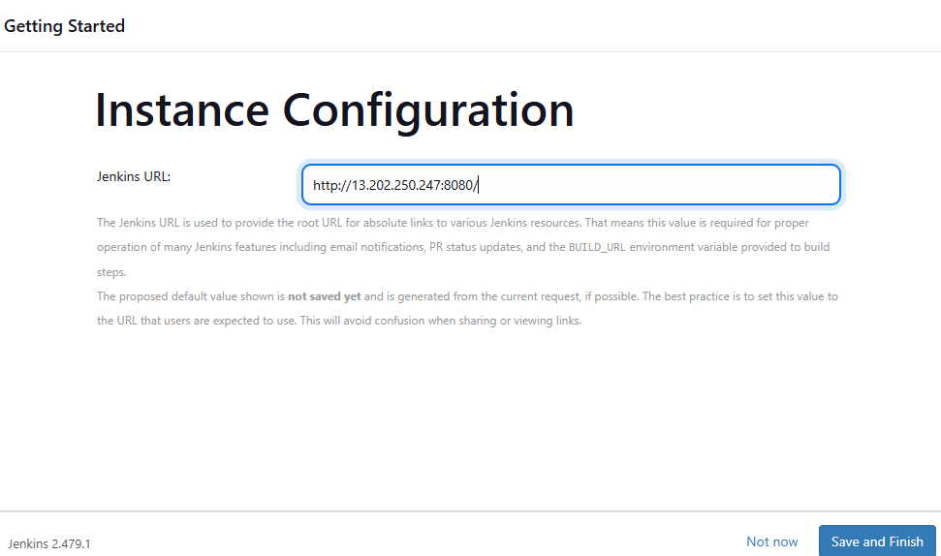
Then the wizard will display the Jenkins URL through which you will be able to access the Jenkins Server. Click on Save and Finish and start using Jenkins.

Slide 29
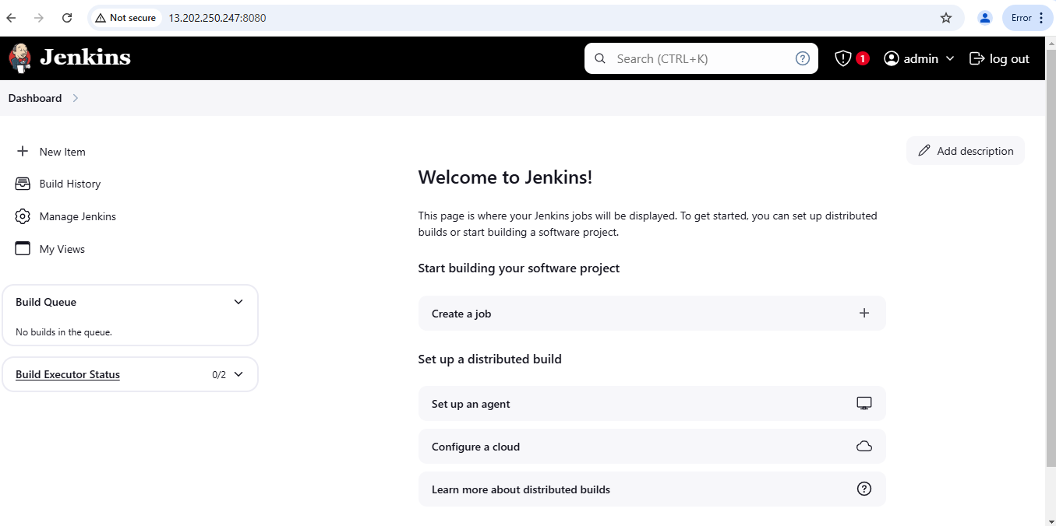
next open the Jenkins dashboard page .

